Slide 1

STAT 5606 Final Project
If your citizens are earning well (relative to the rest of the world), can they live longer?
By Toni Abiru

Slide 2
Topic
For this project, I would like to see if there is a relationship between the GDP per capita of a country and the life expectancy of its citizens.
I will utilize Python libraries and MySQL workbench to conduct this analysis.

Slide 3

Data
The data for this project was gotten from the World Bank Open Data platform. I used values from 2017 and 2018 because those are the latest years from World Bank that have data for both GDP per capita and Life Expectancy. (As at 20th November 2020)
GDP Per Capita: https://data.worldbank.org/indicator/NY.GDP.PCAP.CD
Life Expectancy: https://data.worldbank.org/indicator/SP.DYN.LE00.IN

Slide 4

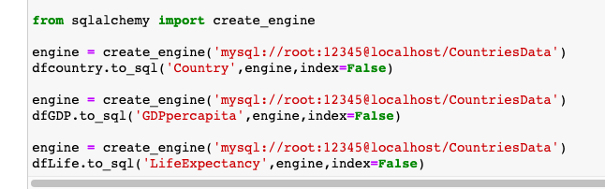
Data importing and storage
By using Python read functions, the MySQL connection & SQL alchemy, I was able to create dataframes in Panda and databases in MySQL for my data.

Slide 5

Data importing and storage
Missing values: No real issue, when the dataframes where created, the null values were addressed. However, I still tried to address them as I connected the SQL data to Jupyter notebook, just in case.
Outliers: While some outliers existed in the data, especially for GDP per capita, I decided to include it because it wasn’t significant. Also, outliers would be interesting in this scenario because they would indicate countries that are doing very well or need to improve significantly.

Slide 6
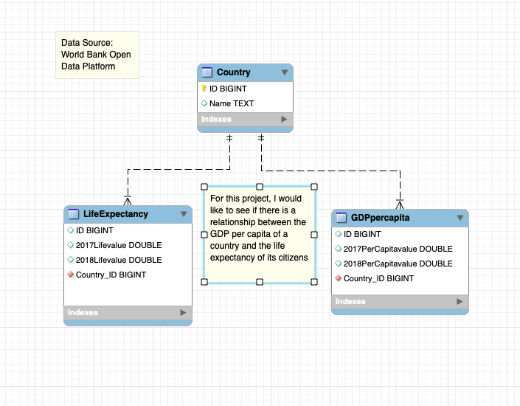
Data storage in MySQL
Importing the Python dataframes into MySQL columns, reverse engineering to establish the ERD relationship

Slide 7
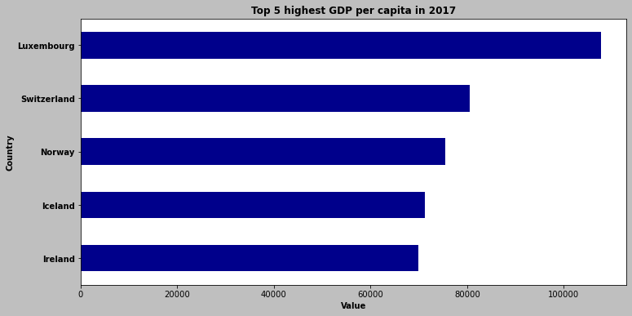
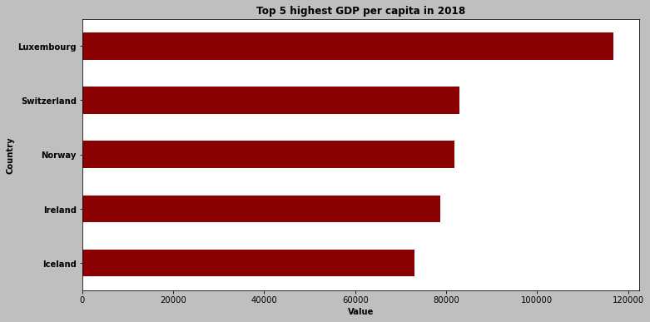
Data Analysis: Introduction
The first step was to get some interesting descriptive top 5 data for the GDP per capita and Life Expectancy in both of our years (2017 and 2018)
This was done using Python pandas and matplotlib

Slide 8
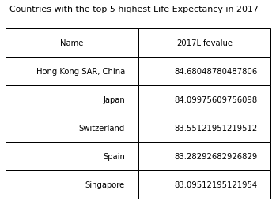
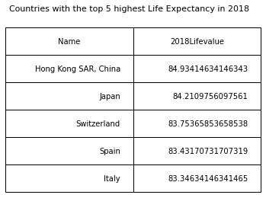
Data Analysis

Slide 9
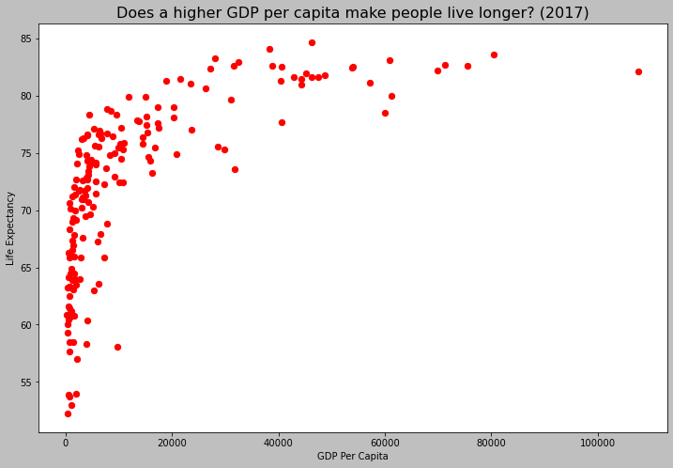
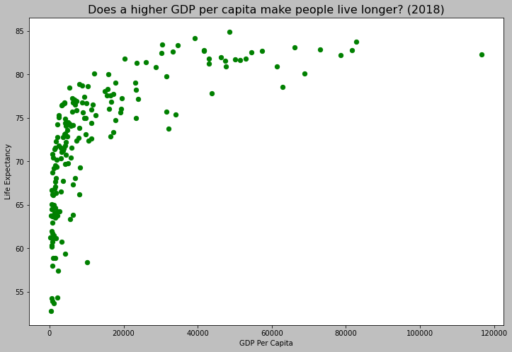
Data Analysis: Scatterplots
Next is the creation of scatterplots with matplotlib to see the most basic relationship of the data in both years. Appears to be slightly positive.

Slide 10
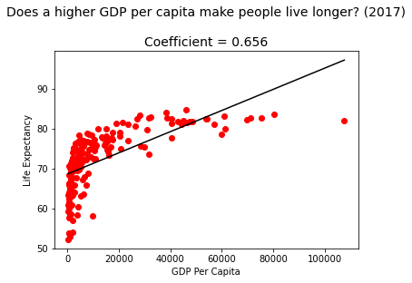
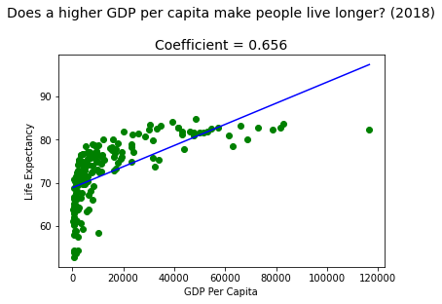
Data Analysis: Correlation
By using Python Matplotlib, we can see the correlation of the points.
The correlation here is 65.6% for both years which suggests that they a positively correlated with medium strength.

Slide 11

How can we be more certain?
By calculating some regression using Python sklearn library.
As we can see from r², there is a chance that the variation in Life Expectancy that can be explained by GDP per capita is 43%.
While it is a different number from the correlation figure, it still suggests that a positive relationship exists between the GDP per capita of a country and the Life Expectancy of the country.

Slide 12
Other key findings
The country that performed the best in terms of the relationship was Luxembourg. (Avg GDP per capita: about $112,000, Avg Life Expectancy: about 82 years)
The countries that performed the worst were Nigeria, Sierra Leone, Chad, Lesotho and Central African Republic. (Avg GDP per capita: about $972, Avg Life Expectancy: about 54 years)

Slide 13
In conclusion
There is some positive relationship between GDP per capita and Life Expectancy. So, it is possible that high GDP per capita lead to higher years of life.
However, we must be aware of the several other lurking variables that may also influence life expectancy. These include Gender, Government spending on health, Crime rates, Mortality rate, Access to Healthcare, Average citizen level of education etc.

